Slide 1
COB+
The next generation of COBs
Ravish Arora
BG Home, Growth markets
April 2016

Slide 2
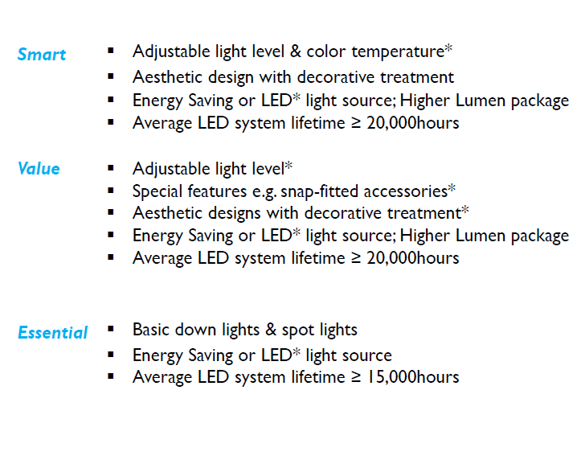
SPOT and Down Lighters Positioning – India Market
Smalu
90112
Aura
Ultra Slim+
Astra
COB+

Slide 3
COB+ Essential LED spots
Highlights
First time from Home BG in High Wattages too for 18W/22W apart from 7W/12W
Super bright light spectrum
Delivers 1700 Lumens for 22W and 400 Lumens for 7W
Super robust construction
Wide voltage protection from 160V – 360V and surge up to 2KV
Premium white metal housing made of aluminum
Delivers good performance on high temperature and heat resistance
Long life with LED technology
No harmful UV radiation

Slide 4
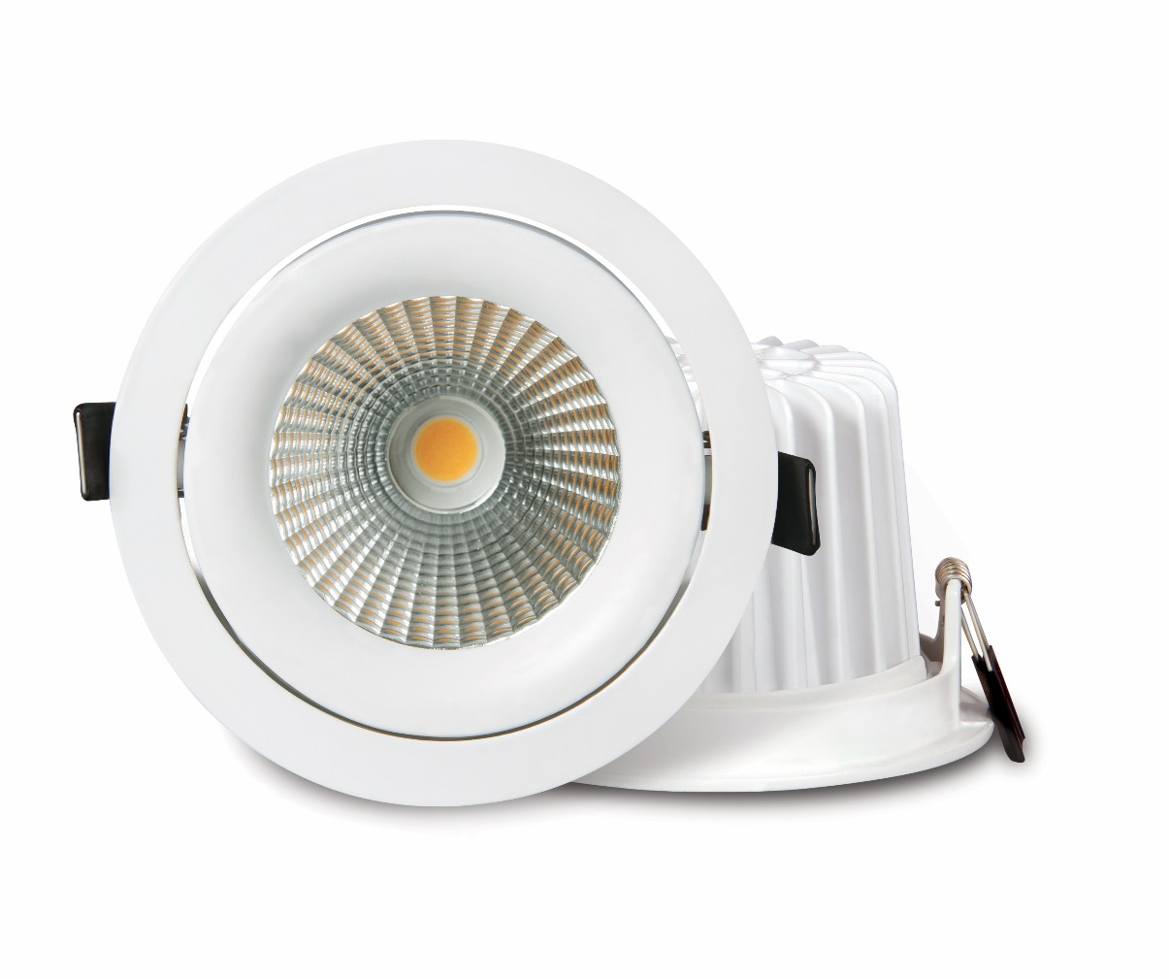
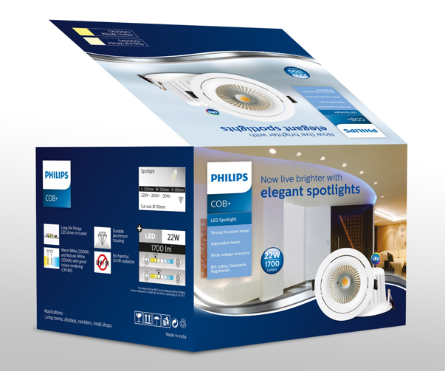
COB+ 22W
Philips
LED COB 22W Round
5000K: 59156/31/85
3000K: 59156/31/83
Essential
Long Life LED source
Strong focused adjustable beam
Wide voltage protection (160-360V) Surge protection up to 2KV
Premium Material – die cast aluminum
BIS safety standards registered
General Specs
Application | Downlighter
Color & Material | White & Aluminum
Lamp base & wattage (Color Temperature) | LED 22W, 240V 50Hz 3000K,5000k
Dimensions (L X W X H)mm | 120 mm (W) x 80 mm (H)
Cut out | 110 mm
Lumen Output | 1650 lm (WW) / 1700 lm (NW)
Master Pack | 12
MRP | 2700 INR

Slide 5
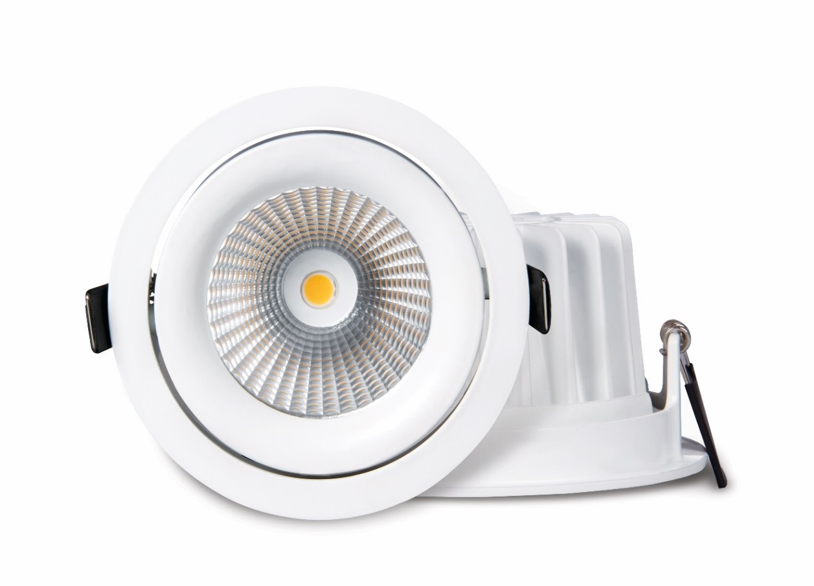
COB+ 18W
Philips
LED COB 18W Round
5000K: 59155/31/85
3000K: 59155/31/83
Essential
Long Life LED source
Strong focused adjustable beam
Wide voltage protection (160-360V) Surge protection up to 2KV
Premium Material – die cast aluminum
BIS safety standards registered
General Specs
Application | Downlighter
Color & Material | White & Aluminum
Lamp base & wattage (Color Temperature) | LED 18W, 240V 50Hz 3000K,5000k
Dimensions (L X W X H)mm | 120 mm (W) x 65 mm (H)
Cut out | 95 mm
Lumen Output | 1200 lm (WW) / 1300 lm (NW)
Master Pack | 12
MRP | 2400 INR

Slide 6
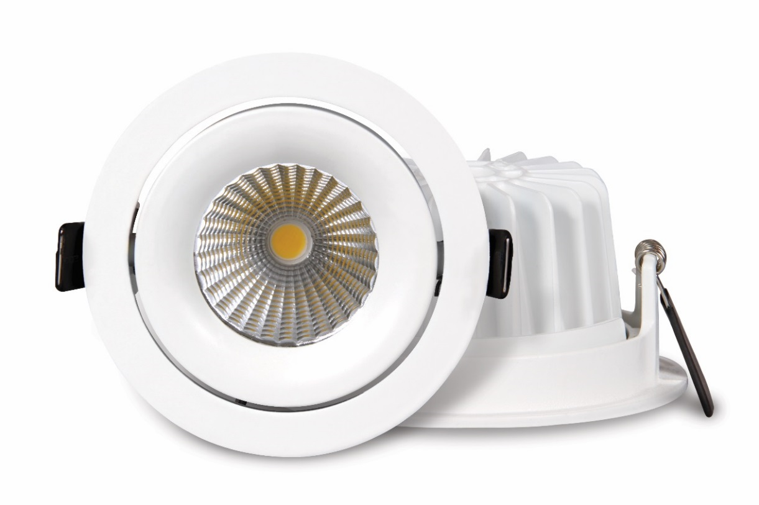
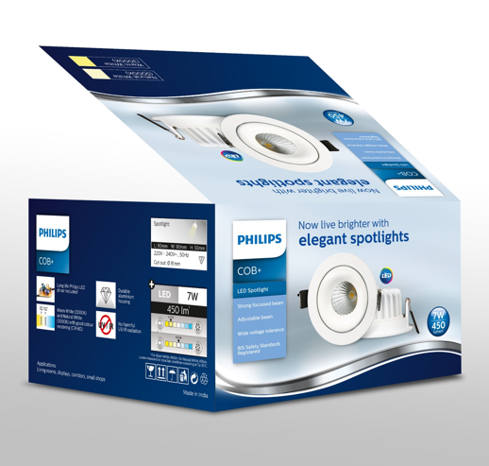
COB+ 12W
Philips
LED COB 12W Round
5000K: 59107/31/85
3000K: 59107/31/83
0x0.0W
included
Essential
Long Life LED source
Strong focused adjustable beam
Wide voltage protection (160-360V) Surge protection up to 2KV
Premium Material – die cast aluminum
BIS safety standards registered
General Specs
Application | Downlighter
Color & Material | White & Aluminum
Lamp base & wattage (Color Temperature) | LED 12W, 240V 50Hz 3000K,5000k
Dimensions (L X W X H)mm | 105 mm (W) x 52 mm (H)
Cut out | 95 mm
Lumen Output | 800 lm (WW) / 900 lm (NW)
Master Pack | 12
MRP | 1700 INR

Slide 7
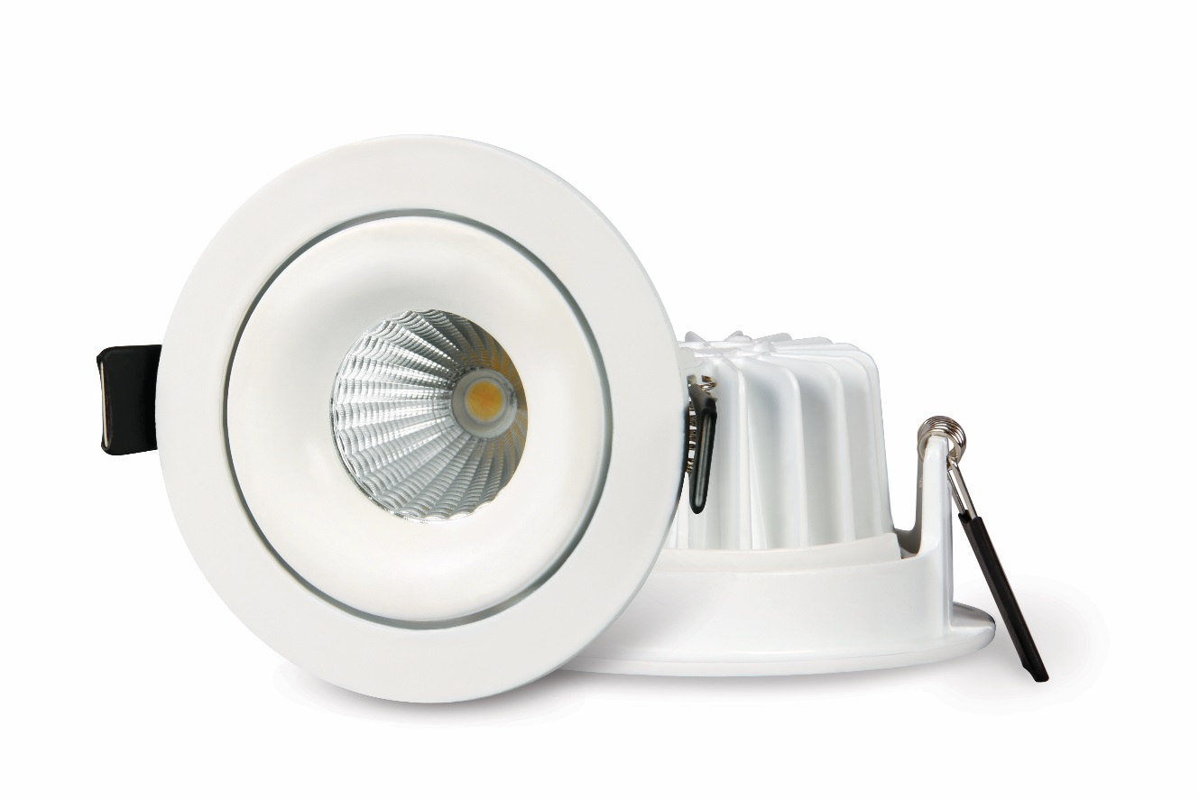
COB+ 7W
Philips
LED COB 7W Round
5000K: 59106/31/85
3000K: 59106/31/83
0x0.0W
included
Essential
Long Life LED source
Strong focused adjustable beam
Wide voltage protection (160-360V) Surge protection up to 2KV
Premium Material – die cast aluminum
BIS safety standards registered
General Specs
Application | Downlighter
Color & Material | White & Aluminum
Lamp base & wattage (Color Temperature) | LED 7W, 240V 50Hz 3000K,5000k
Dimensions (L X W X H)mm | 90 mm (W) x 50 mm (H)
Cut out | 81 mm
Lumen Output | 400 lm (WW) / 450 lm (NW)
Master Pack | 12
MRP | 1275 INR

Slide 8
FAQs
Q: What is CCT?
A: CCT or color temperature refers to the hue of white light (ie. warm white, cool daylight).
CCT describes whether white light appears warm (reddish), neutral, or cool (bluish), based on the appearance of light emitted by a black body heated to various temperatures in degrees of Kelvin (K). CCT is based on one’s own preference.
Q: Why is Philips products better in Color Consistency?
A: Philips has a strong process of LED selection (binning) that ensures that the CCT remains same for an SKU and there is no variation among stocks. This ensures that your home will always have uniform and even light within and across rooms.
Q: What is CRI?
A: CRI or color rendering is the ability of light to show the true colors of objects. CRI measures the ability of a light source to reproduce the colors of various objects faithfully in reference to an ideal light source. Philips offers above 80 CRI, creating comfortable lighting environment, also a measure of product quality.
Q: How to define a good LED downlight?
A: The first step to evaluate an LED DL is light efficacy, or brightness: Philips COBs provide up to 75 lumen/watt light efficacy, it is much brighter than traditional energy-saving lamps, which provides only about 30 lumen/watt; the second criteria is color performance, evaluated by our >80 color rendering index (CRI). Low-quality LED DL are potential fire hazards and thus pose a certain level of risk to users. Quality assurance can be derived from certification and rigorous thermal tests. Philips is in full compliance with IEC60598 standard

